Slide 1
Programming Language
Group:15
teammates:陳麥克55% 林柏安45%
Notes:
請用投影片放映(第4頁)

Slide 2
What we have learned in class---
Make some matrices to calculate.
Use “plot”,”subplot” to make figures.
Learn how to use “for” ,”if”…etc.
Beautify the figure with “axis” , “legend”…etc.
Simplify the program.
Use it to simulate an easy physical experiment.
TEAM WORK and FIND INFORMATION in INTERNET.

Slide 3
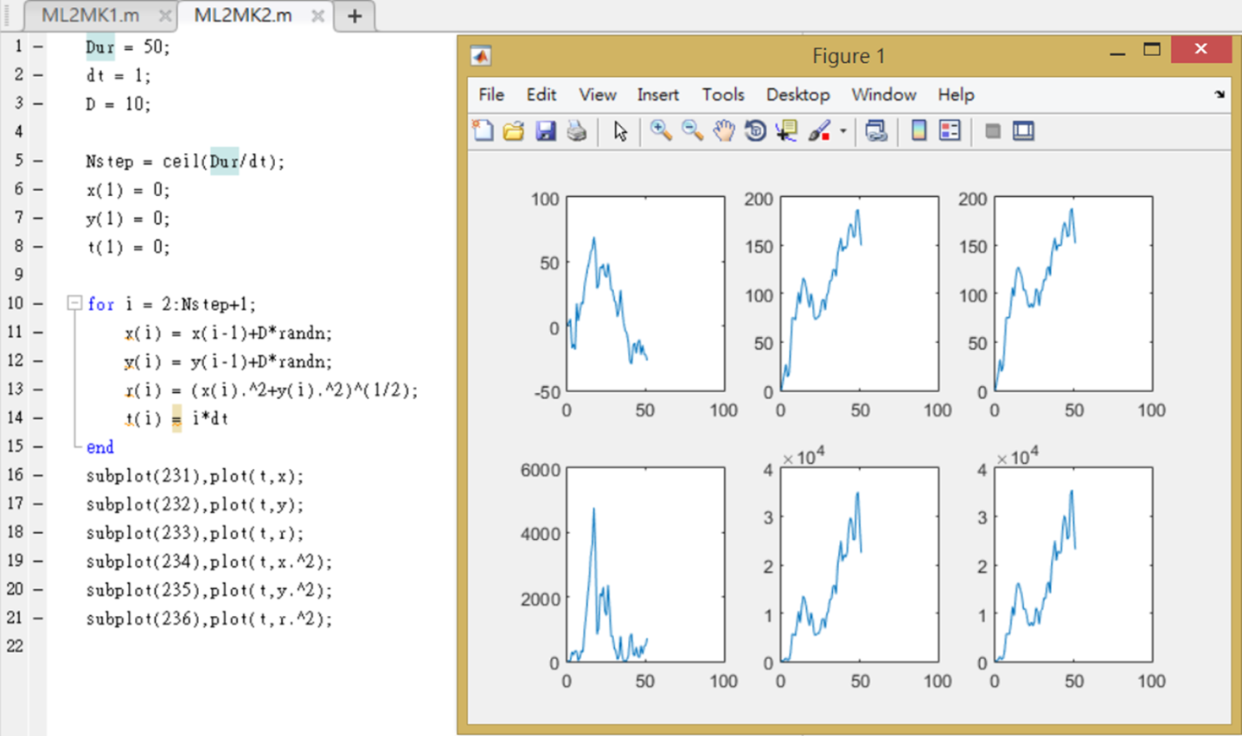
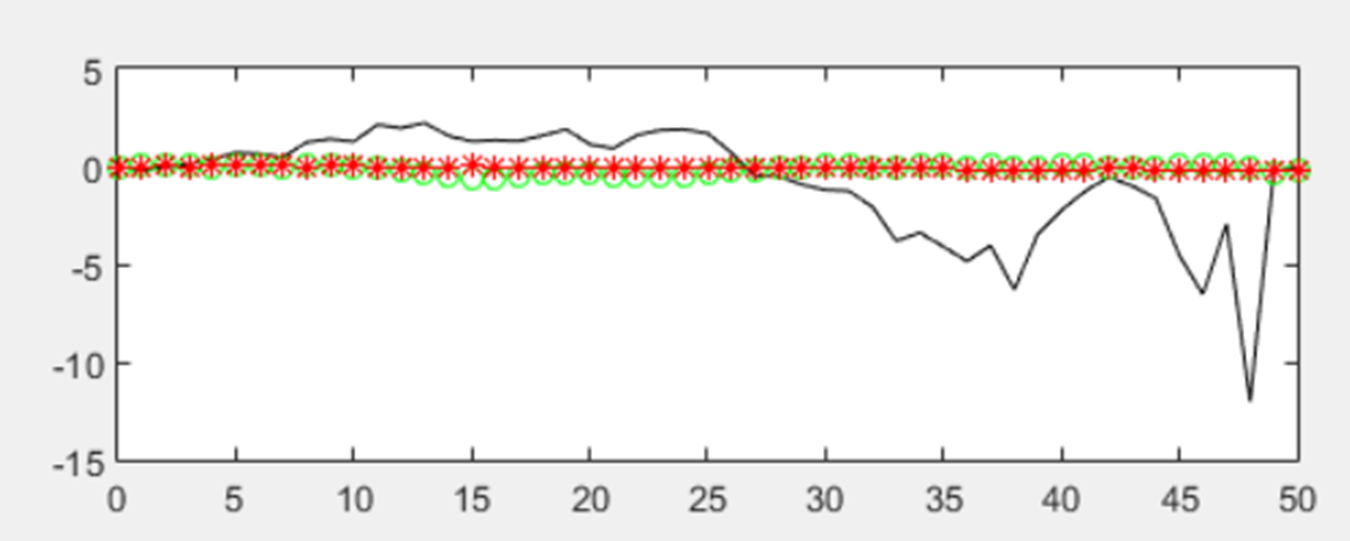
Plot and Subplot
We can use these command to know what the relation in different situation.

Slide 4
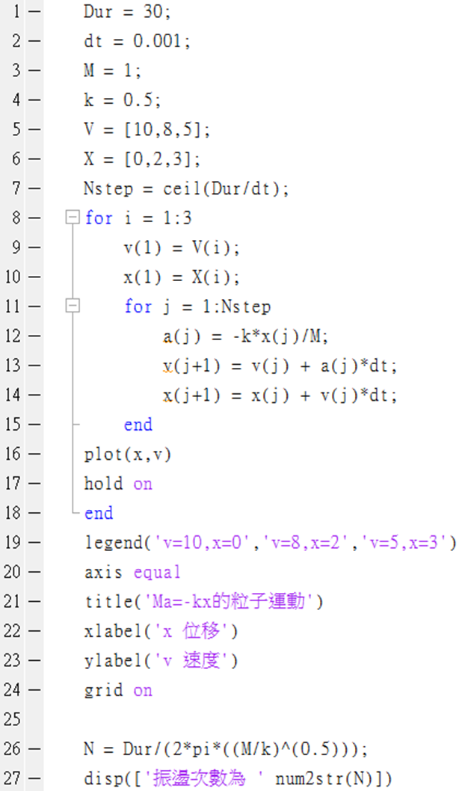
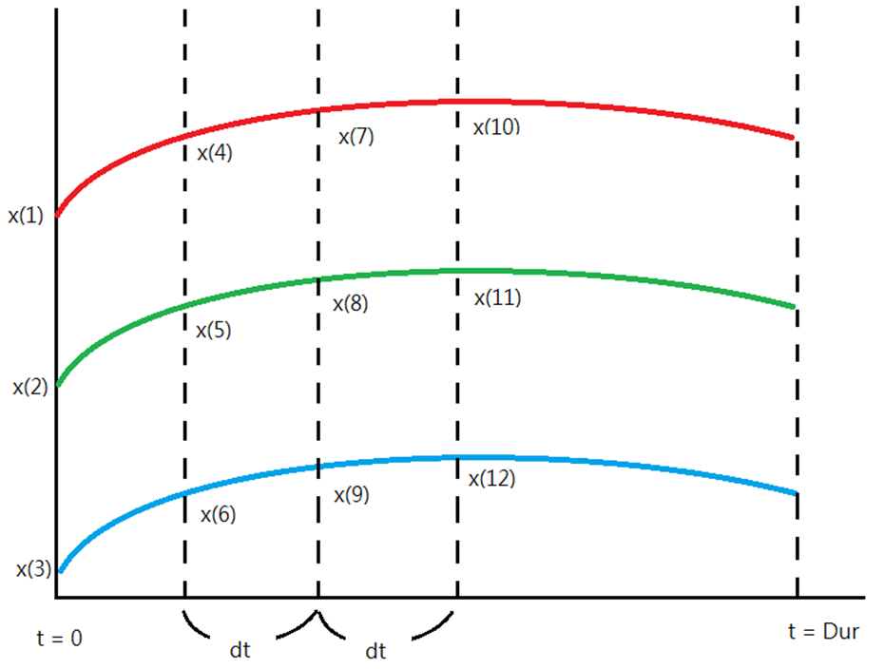
“for” loop
We can use to calculate and plot the object’s
motion at different time within same steps.
And we also learnded how to use double loop.

Slide 5
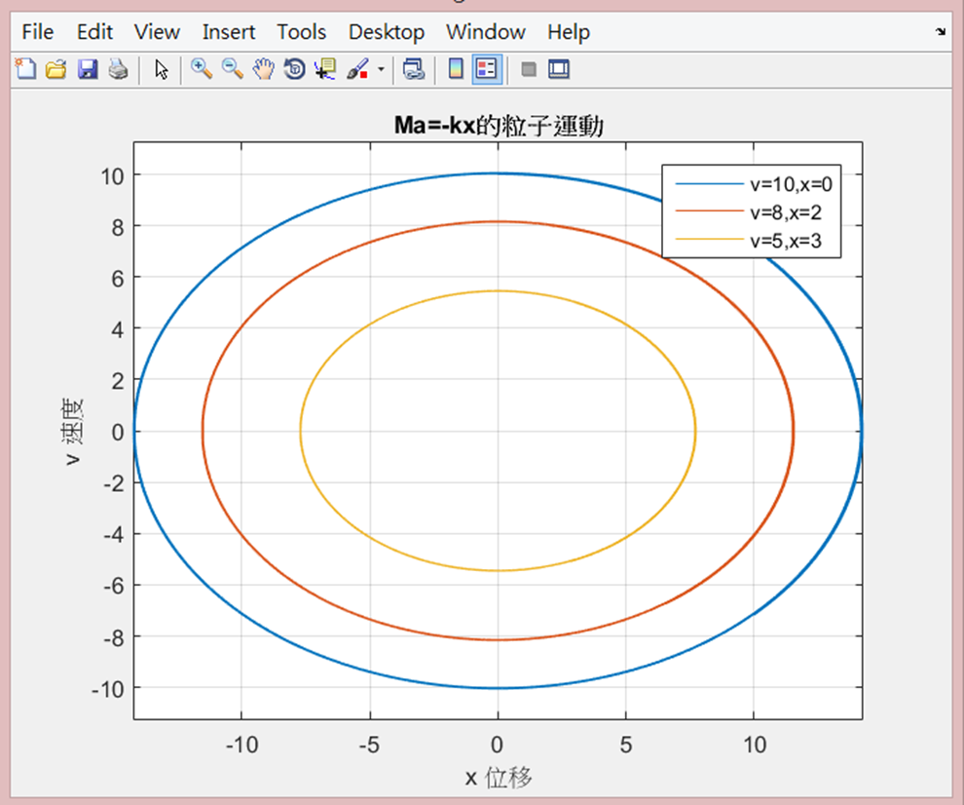
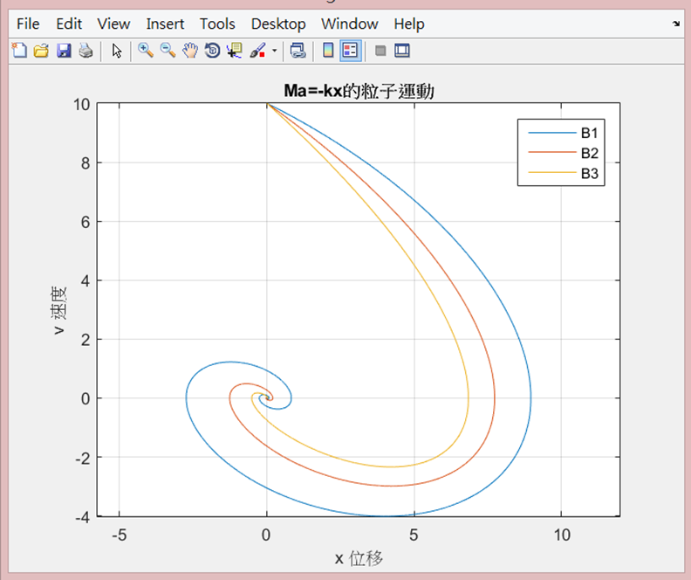
Beautify the figures
Commands:
grid on xlabel('x 位移')
axis([-10 10 -10 10]) ylabel('v 速度')
title('Ma=-kx的粒子運動') legend('B1','B2','B3')

Slide 6
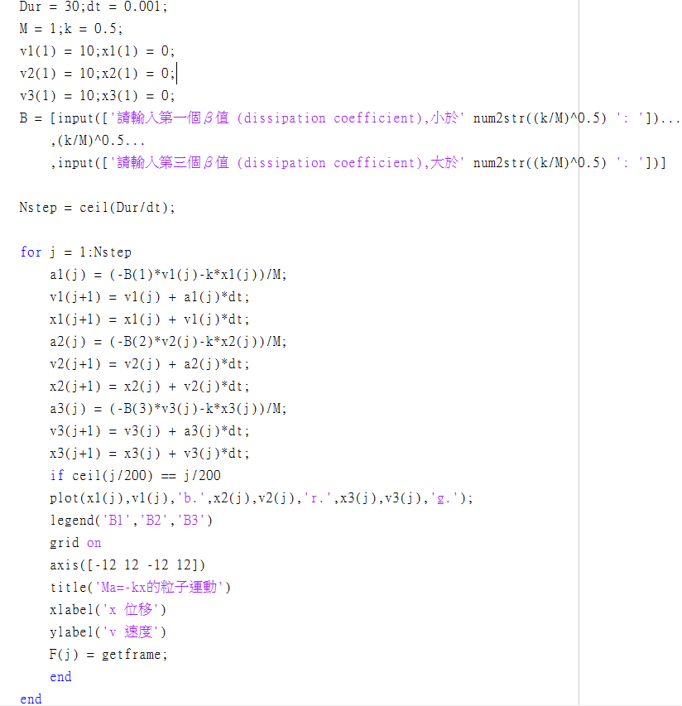
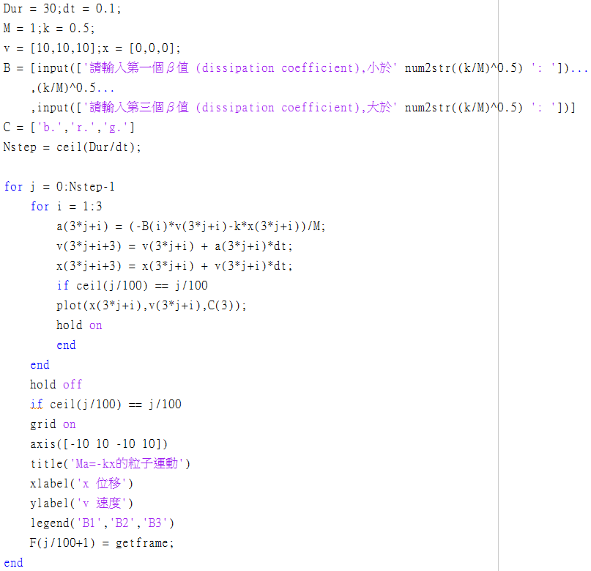
Modify and simplify the program
WRONG
CORRECT

Slide 7
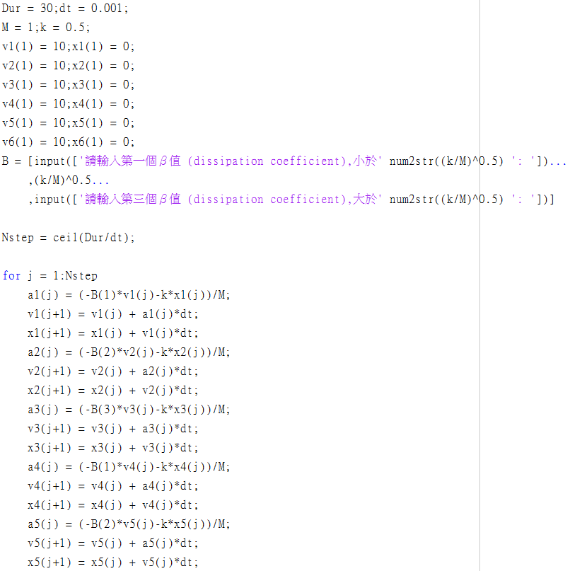
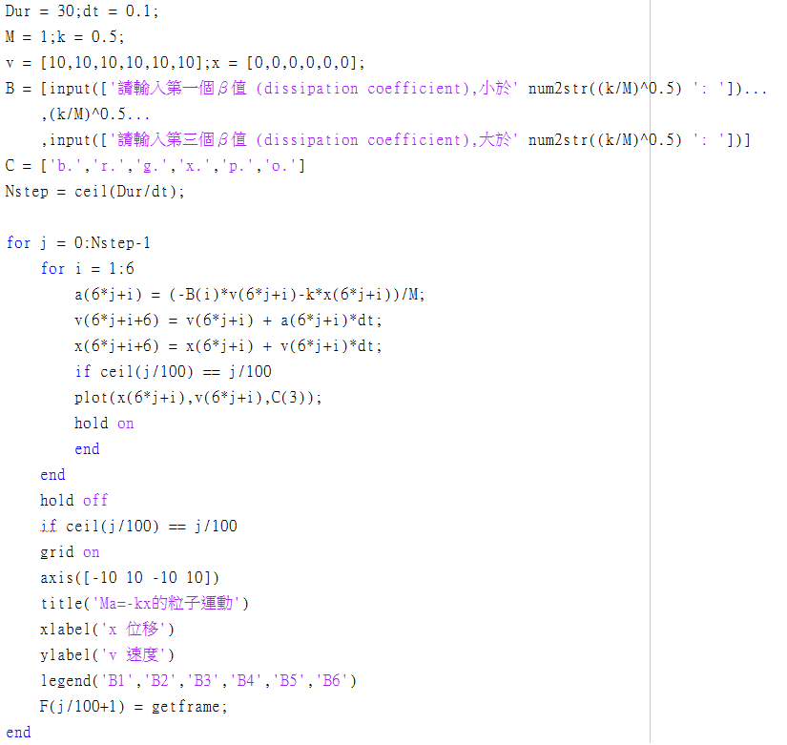
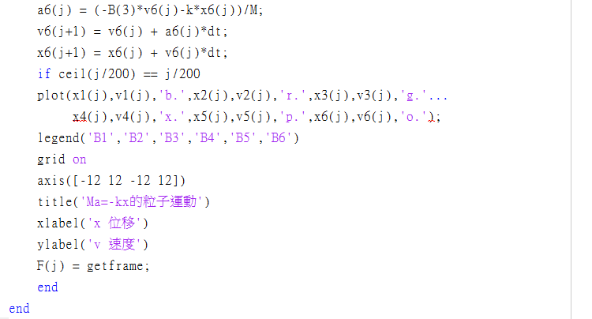
Modify and simplify the program
From this
To This
Can’t figure out where is the different between these programming language?
Let’s add more objects motion!

Slide 8
Find some information~~~(example)
How to make a gif ???
Use the special website to
convert a Video into gif.
How can I change numbers to the string?
Use “num2str”.
(number to string)

Slide 9
Maybe one day …
We can completely learn how to
simulate any physical experiment ! ! !

Slide 10
The End
づ(・ω・)づ Thanks~

